Slide 1
COMP1004: INTERIM VIDEO - Typing TESTS
By Max Ferguson

Slide 2
Project Vision and background.
Why am I doing it?
Personal goal to increase typing speed as much as I can since 2020.
Who it’s for?
Employers and learners
Why?
To test potential hire’s typing speeds and to practice typing
Why is it important?
To improve collaboration between team members within office jobs
To improve efficiency in administers jobs
Databases need accurate data
Multitasking and efficiency
Improved response times to customer
Ethical, legal and social considerations?
Legal – Privacy concerns based on storing their information.
Social – Accessibility concerns based on different input methods

Slide 3
sprints
SPRINT 1 (WEEK 1 & 2) | SPRINT 2 (WEEK 3 – 4) | SPRINT 3 (WEEK 4-6)
Goals - Create and display user stories - Create a flowchart to display the logic of website (basic logic to be used in prototype) - Create a wireframe using Figma (UI) -Create UML for prototype logic | Goals - Create a skeleton of the code - To amend ULM + Flowchart to match actual logic if any mistakes - Adhere to wireframe - Create a working prototype Can do a 60second typing test for randomised array of words Gets WPM (words per minute) | Goals - Create new flowchart to show new structure - Redo UI to fit the wireframe - Implement the feature to change the timer of typing test - Display WPM + timer onto website rather than console - Make correctly inputted words autodelete on submit - Creation of proper testing - randomised input array generation
Status - Completed - Goals met | Status - Completed - Goals incomplete | Status - Incomplete
Next steps - Using UML and flowchart as base create a working prototype | Next Steps - Adhering to the wireframe UI design - Implementing new features Time options and difficulty options+ pseudo-random expected inputs - Polish of previous features words get auto deleted in input box, WPM + timer displayed on website not console + randomised array IS NOT DONE | Next Steps - (Assuming goals completed), implement option to change timer and ensure WPM calculation changes based on the timer change and show errors live

Slide 4
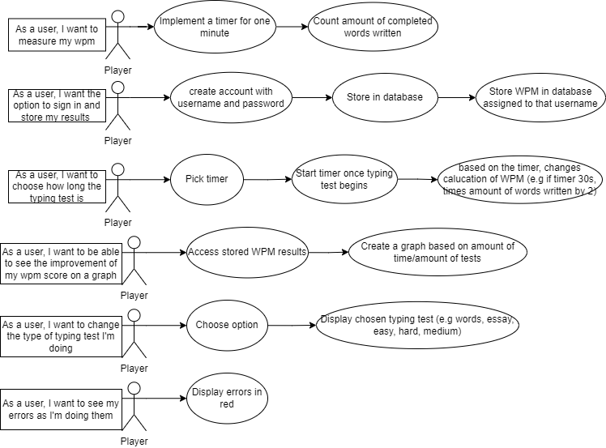
USER STORIES

Slide 5
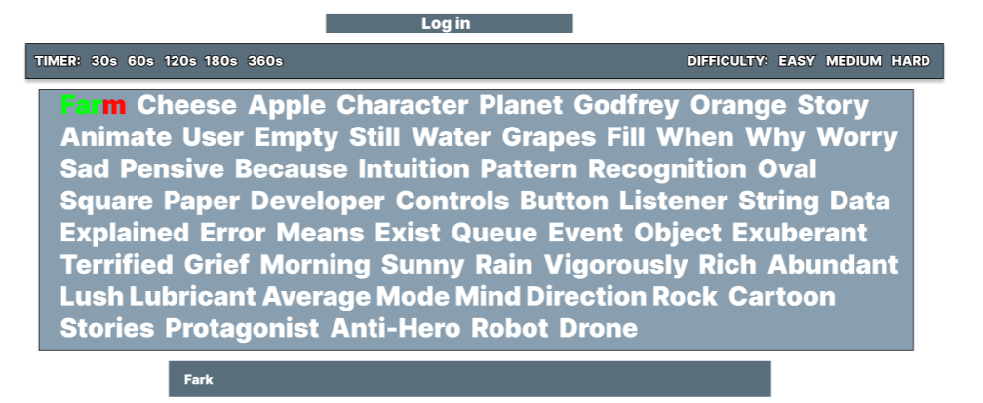
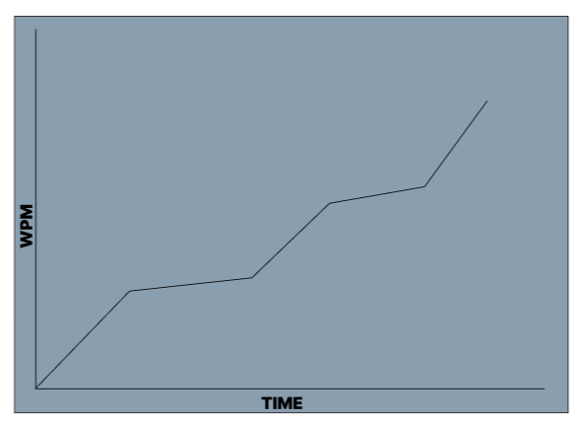
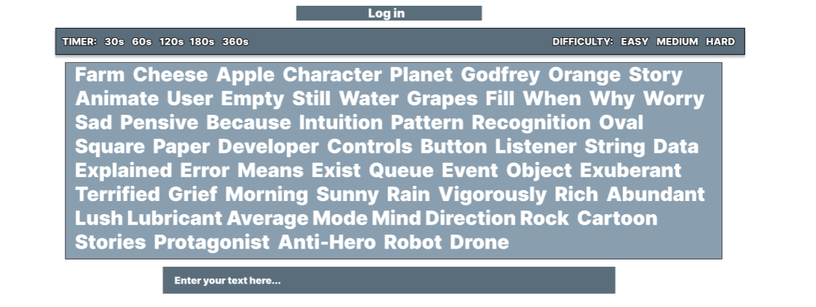
WIREFRAME
Here is what I’d like my website to ideally look like by the end of this project

Slide 6
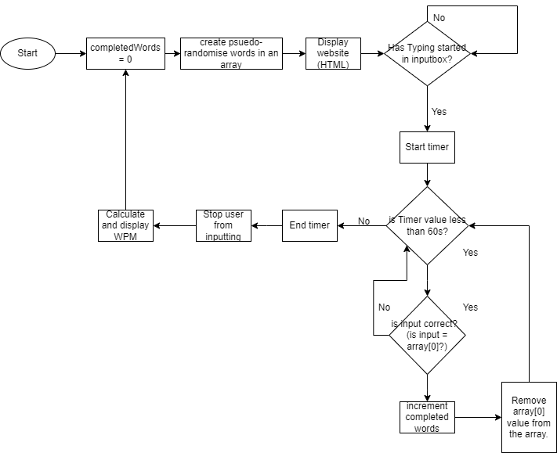
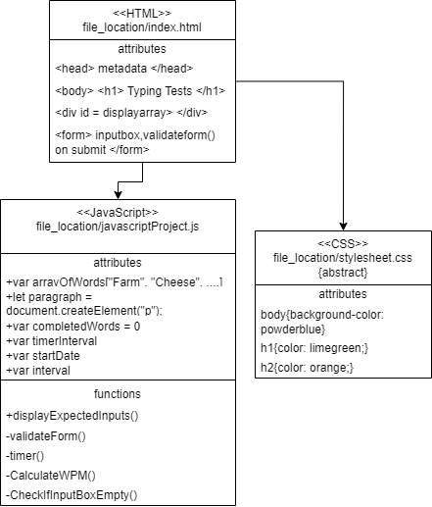
ULM + FLOWCHART OF PROTOTYPE

Slide 7
Show prototype ☺

Slide 8



Challenges I’VE FACED
Coding challenges
Novice at JavaScript, HTML and CSS
Time management with other projects
Initial creation of validation of input
Implementation of timer
Creation of pseudo-random words as expected input

